Slide 1

Fine-Tuning
Large Language Models
From full fine-tuning to LoRA, QLoRA, and RAG
CONCEPTS
METHODS
DECISIONS
Notes:
Open by framing fine-tuning as one of several ways to adapt an LLM.
Tell the audience the goal is to understand what changes inside the model, why LoRA and QLoRA are efficient, and when RAG is a better choice.
[Sources]
Visual on this slide was generated with Microsoft Copilot.
QLoRA paper: https://arxiv.org/abs/2305.14314

Slide 2
What is fine-tuning?
A pre-trained generalist becomes more specialized through additional training.
BASE MODEL
FOCUSED DATA
SPECIALIZED MODEL
Broad language patterns
General knowledge
General behavior
＋
Examples of desired
inputs, outputs, tone,
or domain patterns
→
Behavior is adapted
for a task, domain,
format, or style
Notes:
Fine-tuning continues training on a smaller targeted dataset.
It changes trainable parameters so the model is more likely to produce the desired patterns.
Fine-tuning is not the same as simply attaching documents at inference time.

Slide 3
Why use fine-tuning?
Use it when desired behavior should be consistent across many requests.
Tone & style
Specialized behavior
Shorter prompts
Teach brand voice, response format, vocabulary, or a professional writing style.
Adapt for classification, extraction, code conventions, or domain terminology.
Reduce repeated instructions by learning stable patterns from examples.
Best fit: repeated patterns and behavior
Not the first choice for rapidly changing facts or content that must be cited.
Notes:
Emphasize that fine-tuning primarily changes behavior and patterns.
For frequently changing factual knowledge, RAG is often easier to update and can provide sources.

Slide 4
How fine-tuning works
The training loop compares a model response with a target and adjusts trainable parameters.
1
→
2
→
3
→
4
→
5
Base model
Training example
Model output
Calculate loss
Update weights
Repeat across many examples and training steps
Notes:
Explain the sequence from example to prediction to loss and parameter update.
In full fine-tuning, all model weights may be trainable. In PEFT, only a small subset is trainable.

Slide 5

Common adaptation methods
These methods solve different parts of the alignment and efficiency problem.
Supervised fine-tuning
Instruction fine-tuning
Learn from labeled input-output examples
Full or partial weights
Learn to follow natural-language requests
Usually supervised training
PEFT
RLHF
Train a small parameter subset
Adapters, LoRA, prompt tuning
Optimize preferences using human feedback
Reward model + policy optimization
Notes:
Supervised fine-tuning is a training objective, not necessarily an all-weights method.
Instruction fine-tuning is usually a form of supervised fine-tuning using instruction-response pairs.
PEFT is a family of techniques that reduces trainable parameters.
RLHF is a separate preference-optimization pipeline and can be used after supervised fine-tuning.
[Sources]
Visual on this slide was generated with Microsoft Copilot.

Slide 6
Supervised & instruction fine-tuning
Both learn from demonstrations, but instruction data emphasizes following user requests.
Supervised fine-tuning
Instruction fine-tuning
Dataset: labeled input → target output
Good for:
• Classification
• Extraction
• Structured generation
• Domain-specific transformations
Dataset: instruction + context → ideal response
Good for:
• Chat assistants
• Question answering
• Multi-task generalization
• Open-ended instruction following
Notes:
Use a simple example: input review and sentiment label for supervised fine-tuning.
For instruction tuning, show an instruction such as summarize this passage and an ideal response.

Slide 7
Parameter-efficient fine-tuning (PEFT)
Keep most of the foundation model frozen and train only a small set of added or selected parameters.
Adapter layers
LoRA
Prefix / prompt tuning
Small modules inserted between existing layers
Low-rank matrices approximate the weight update
Train continuous virtual tokens or prefixes
Why PEFT? Less optimizer memory • Faster experiments • Small task-specific checkpoints
Notes:
PEFT can reduce the number of trainable parameters by orders of magnitude, though the exact reduction depends on model size and configuration.
The base model still must be loaded, which is why QLoRA additionally quantizes the frozen base.

Slide 8
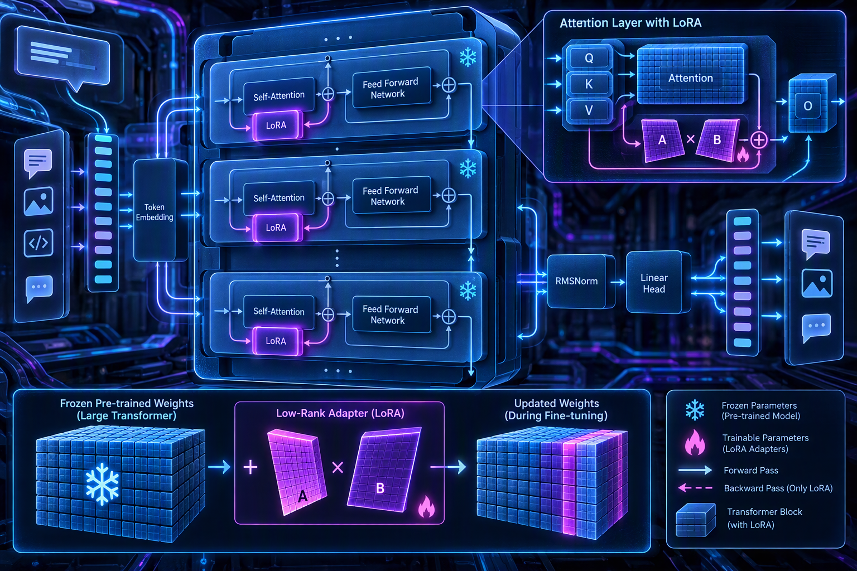
LoRA: Low-Rank Adaptation
Train a compact update while the original weight matrix remains frozen.
Frozen weight
1. Freeze
Keep the pre-trained weights unchanged.
W
＋
2. Add low-rank matrices
Inject trainable A and B into selected linear layers.
B × A
3. Train the adapters
W′ = W + α/r · BA
Backpropagation updates only the small LoRA parameters.
Notes:
LoRA represents the task-specific update as the product of two low-rank matrices.
The rank r is much smaller than the original matrix dimensions.
At inference, adapters can remain separate or be merged into the base weight, depending on the toolchain.
[Sources]
Visual on this slide was generated with Microsoft Copilot.
LoRA paper: https://arxiv.org/abs/2106.09685

Slide 9
LoRA architecture at a glance
Frozen backbone + trainable low-rank path.
Forward pass uses the original transformation plus the learned low-rank update. Only the adapter path receives parameter updates.
Notes:
Use the visual to point out the frozen transformer blocks and the small trainable LoRA components.
Stress that LoRA changes a selected subset of linear layers, commonly attention projections.
[Sources]
Visual on this slide was generated with Microsoft Copilot.

Slide 10
LoRA vs. other tuning approaches
Efficiency depends on what is trained and what must be stored.
Technique | Trainable parameters | Training memory | Base preserved | Portable task module
Full fine-tuning | All | Highest | No | No
Adapter layers | Small subset | Low to moderate | Yes | Yes
LoRA | Small subset | Low | Yes | Yes
Prefix tuning | Very small subset | Low | Yes | Yes
Note: parameter efficiency is low for full fine-tuning and high for PEFT methods.
Notes:
Correct the original table: full fine-tuning has low parameter efficiency because all parameters are updated.
Actual memory and speed vary by optimizer, precision, sequence length, batch size, and model architecture.

Slide 11

QLoRA: quantized LoRA
QLoRA stores the frozen base model in 4-bit form while training LoRA adapters.
4-bit NF4 base
LoRA adapters
Memory optimizations
The frozen model is quantized to reduce memory usage. Weights are dequantized for computation as needed.
Small trainable matrices capture task-specific updates while the quantized base remains frozen.
Double quantization compresses quantization constants. Paged optimizers help manage memory spikes.
Notes:
QLoRA backpropagates through a frozen 4-bit quantized model into LoRA adapters.
Its key innovations include NF4, double quantization, and paged optimizers.
Hardware needs still depend strongly on model size, sequence length, and training configuration.
[Sources]
Visual on this slide was generated with Microsoft Copilot.
QLoRA paper: https://arxiv.org/abs/2305.14314

Slide 12
Direct comparison: LoRA vs. QLoRA
The main difference is how the frozen base model is stored.
Feature | LoRA | QLoRA
Frozen base precision | Commonly FP16/BF16 or 8-bit | 4-bit quantized, typically NF4
Trainable components | LoRA adapters | LoRA adapters
Memory requirement | Lower than full fine-tuning | Lower than standard LoRA
Compute trade-off | No 4-bit dequantization path | Extra quantize/dequantize overhead
Best use | Enough memory for base model | Memory-constrained fine-tuning
Quality | Strong with good data and setup | Can approach 16-bit fine-tuning in studied settings
Notes:
Avoid absolute hardware promises. A single GPU may be feasible for some models and configurations, but not every model.
The QLoRA paper demonstrated a 65B model on a single 48 GB GPU and preserved 16-bit fine-tuning task performance in its reported setup.
[Sources]
QLoRA paper: https://arxiv.org/abs/2305.14314

Slide 13
Why QLoRA changed experimentation
It makes many large-model adaptation projects feasible with substantially less memory.
Lower memory pressure
Adapter reuse
Faster iteration
A 4-bit frozen base leaves more GPU memory for activations, adapters, and optimizer state.
Train multiple small adapters for different tasks and reuse the same base model.
Smaller trainable checkpoints simplify experimentation, sharing, and task switching.
Quality still depends on data quality, evaluation, and training configuration.
Notes:
QLoRA lowers the memory barrier but does not remove the need for careful dataset design and evaluation.
Small high-quality datasets can be more valuable than large noisy datasets.
[Sources]
QLoRA paper: https://arxiv.org/abs/2305.14314

Slide 14

Fine-tuning vs. RAG
A useful analogy: closed-book learning versus an open-book system.
FINE-TUNING
RAG
Changes internal parameters through training.
Best for:
• Tone and style
• Output format
• Stable task behavior
• Domain terminology
Updating requires more training.
Retrieves external content at query time and adds it to the model context.
Best for:
• Changing facts
• Private document knowledge
• Source traceability
• Rapid content updates
Requires retrieval infrastructure.
Notes:
Use the analogy: fine-tuning is learning patterns before the exam; RAG is consulting a library during the exam.
RAG can reduce unsupported factual claims when the right evidence is retrieved, but it does not eliminate hallucinations.
[Sources]
Visual on this slide was generated with Microsoft Copilot.

Slide 15
Choosing the right approach
Start with the problem, not the technique.
Need fresh facts or citations?
→
Use RAG
Need stable tone, format, or behavior?
→
Use fine-tuning
Need low-memory adaptation?
→
Use LoRA or QLoRA
Need both behavior and grounded knowledge?
→
Combine fine-tuning + RAG
Takeaway: Fine-tuning changes behavior. RAG supplies knowledge. LoRA and QLoRA make training efficient.
Notes:
Close with the decision framework.
In real systems, fine-tuning and RAG are complementary rather than mutually exclusive.
End by asking the audience which requirement is dominant: behavior, knowledge freshness, efficiency, or alignment.

